Slide 1
Online Requisitions

Slide 2
Select “Financial Management”

Slide 3
Select “Purchasing”

Slide 4
Select “Requisitions”

Slide 5
Select “Add” in the right hand corner

Slide 6
1) Click the triangle in the Requisition Group box. 2) Select the correct Requisition Group. 3) Select the correct year (example next year is 2021-22) 4) Click in the “Description” box enter a description of the items. This can be a short description, it will not show up when the PO is printed. The items you enter in each detail line will show up on the printed PO. 4) Tab down to “Vendor” and type in the vendor name and select your vendor. 5) The “Ship to” and “Attention” lines should already be entered. 6) Select “Save & Mass Add Detail”

Slide 7
Adding One or More Items (Use the tab key to move to another box) IT’S VERY IMPORTANT TO FILL IN EACH OF THE BOXES AND ENTER A CLEAR DESCRIPTION, THIS WILL SHOW UP ON THE PURCHASE ORDER WHEN IT IS PRINTED Enter “Catalog Number” (some companies like Amazon might not always have a catalogue #) Also with Amazon – please add an attachment with the list of items, so I can order the correct item) Enter “Quantity” Enter “Unit of Measure” Enter “Unit Cost” Enter “Description” You can add up to 5 items at a time After entering your items, select “Save” If you need to order more items, select “Mass Add Detail” again and you can order 5 more items. You can do this as many time as you need to. After you are done entering items, select “Save” for the last time and now you need to add your accounts

Slide 8
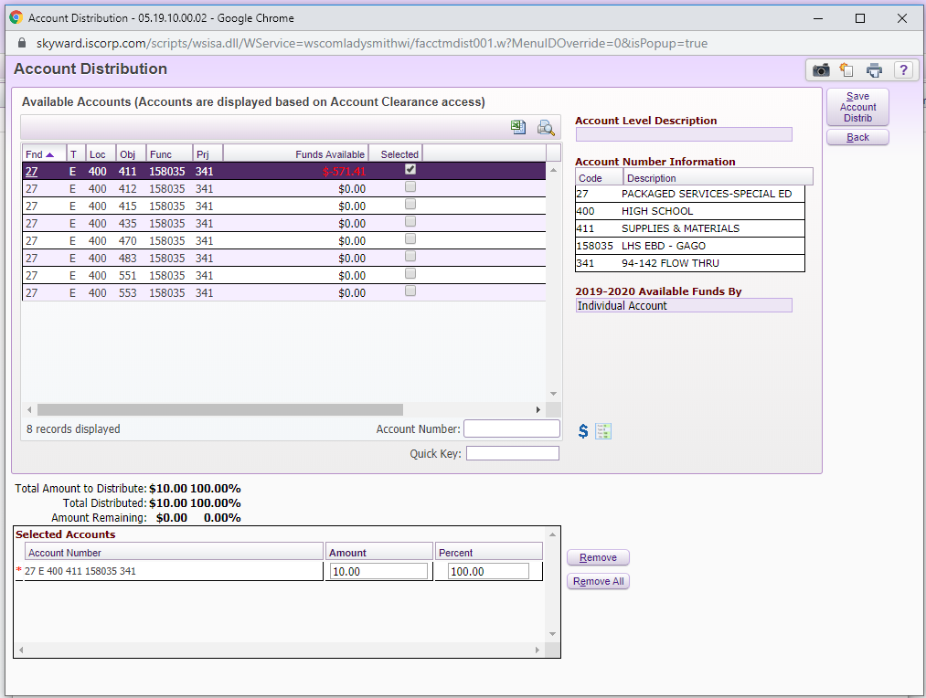
Select “Add Requisition Accounts” 1) Select all of the accounts that apply to your order (if you have supplies (411), for paper (417), for a stool (440) 2) Then breakdown the amount for each account and put that in the amount column. 3) Select “Save Account Distrib”. This takes you back to the main “Requisition Detail Lines/Accounting page”

Slide 9
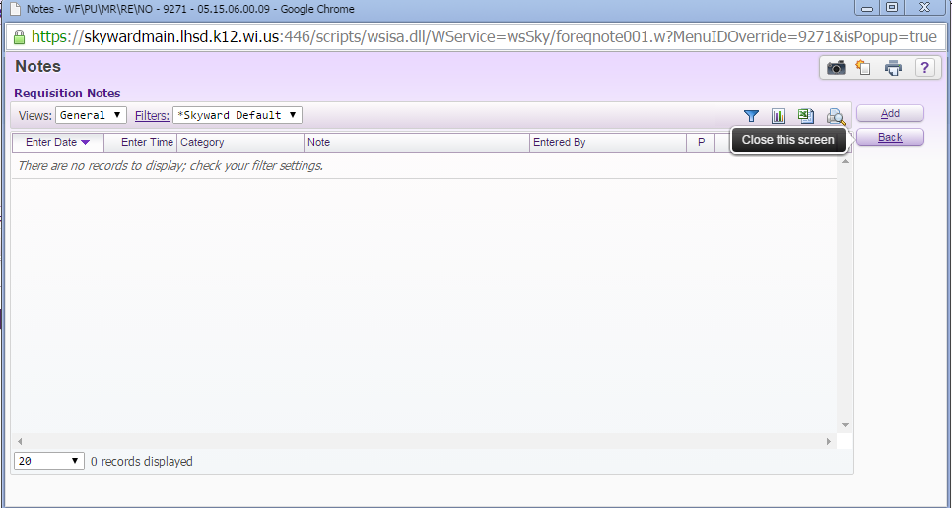
Adding Notes If you need to add any notes to the requisition, select “Notes” Then select “Add” (Notes can include a promo code or anything you need to tell me regarding the purchase)

Slide 10
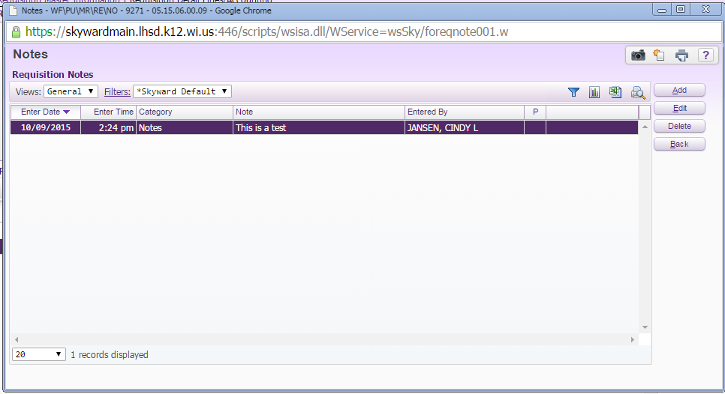
Highlight “Note Category” and select notes Click in the “Note” box and type in your note Click on “Save” When you get to the “Requisition Notes” screen you can add another note or click on “Back” to get back to your requisition

Slide 11
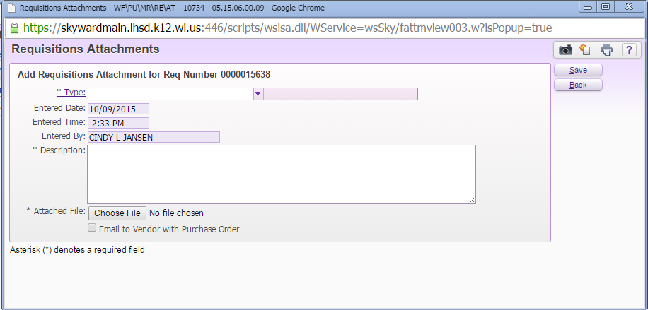
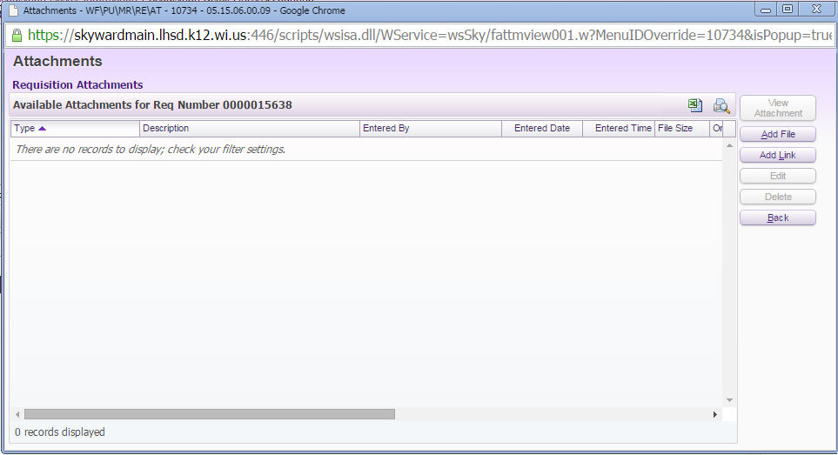
Adding Attachments (You will first need to scan and save the document to your computer) Select “Attachment” Select “Add File” Enter “Type” as “Attachments” Enter Name of file in “Description” box Select “Choose File” Select the saved file that’s on your computer Select “Open” when you find the correct file

Slide 12
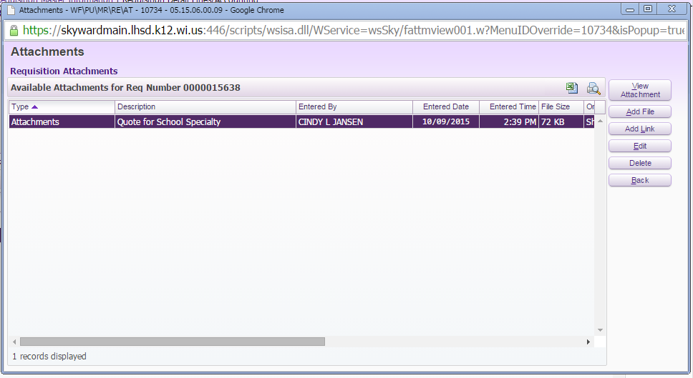
Select “Save” If you want to add another attachment select “Add file” again If you are done adding attachments, select “Back”

Slide 13
You can see on the Requisition Master Information there are two ** by the “Note” button and the “Attachment” button. This means you have notes and attachments for this requisition. If you are finished with this requisition and want to submit it select the “Submit for Approval” button. This will send it to your building principal to be approved and start the chain of approval. If you need to stop and finish your requisition later, select “Save & Finish Later” and you can come back to this requisition.

